Slide 1
A Sketch-based Interface for Modeling Myocardial Fiber Orientation
Kenshi Takayama¹ Takeo Igarashi^{1,2}
Ryo Haraguchi³ Kazuo Nakazawa³
¹The University of Tokyo
²JST SORST
³National Cardiovascular Center
Research Institute

Slide 2
Introduction
Background
Related work
Basic idea
User Interface
Algorithm
User Experience
Conclusion

Slide 3
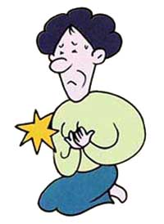
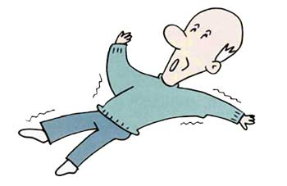
Background
50,000 die from cardiac sudden death
Abnormal heart rhythm is its major cause
Its mechanism is not clear
Notes:
heart disease
Japan, 2005
second biggest cause of death
90 thousand people
sudden death
die unexpectedly
mechanism
very unclear
心疾患は日本人の死因の第2位
心臓突然死の数は年間 約9万人
その80~90%は頻拍・細動 などの致死性不整脈が原因
治療法が確立されていない
不整脈対策は 国家的重要課題！

Slide 4
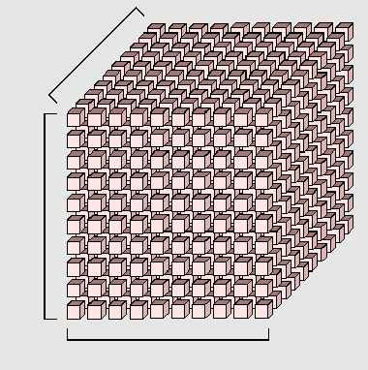
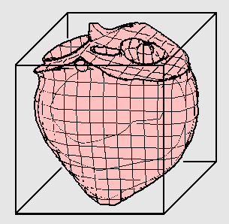
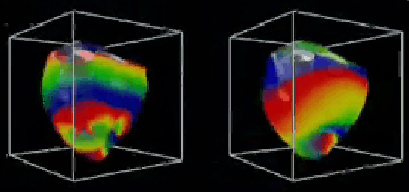
Simulation approach
Mathematical model
Elucidation
Prediction
Education
Notes:
300x300x300

Slide 5
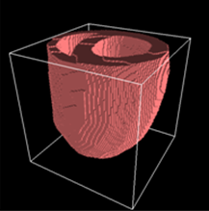
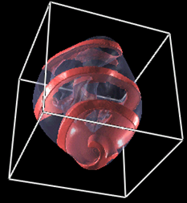
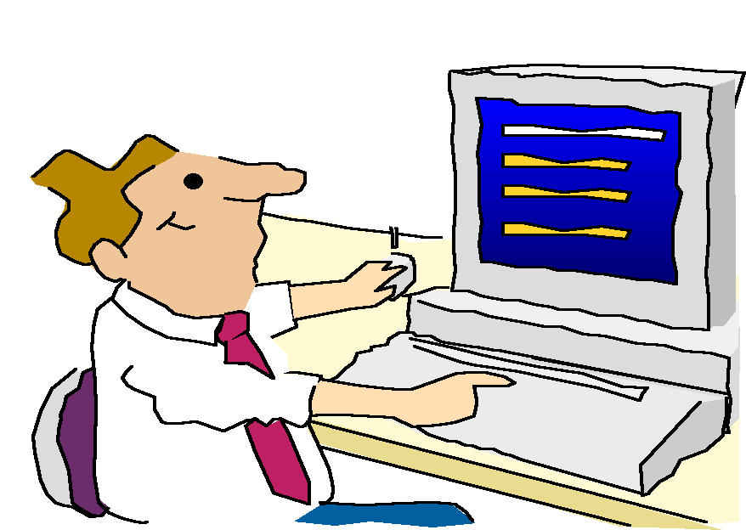
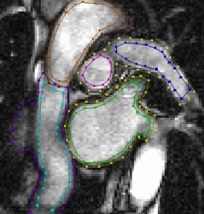
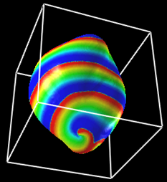
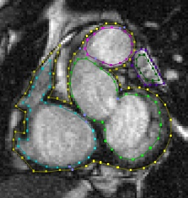
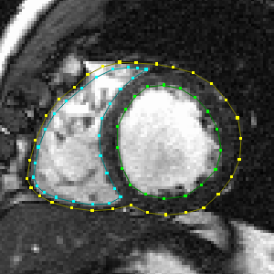
3 stages of process
Bottleneck
Modeling
Simulation
Evaluation

Slide 6

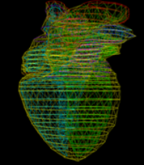
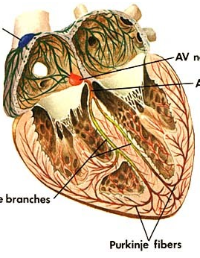


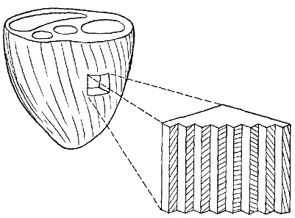
Various parameters
Geometry
Purkinje fiber network
Our target
Myocardial fiber orientation
Notes:
Shape
Purkinje fiber
Myocardial fiber orientation
心室較差
筋電位持続時間(APD)

Slide 7
Previous method
Take 2D slices from xyz direction
Specify vectors one-by-one
Very tedious

Slide 8
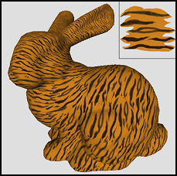
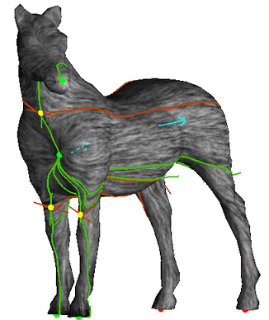
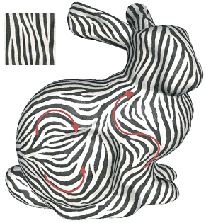
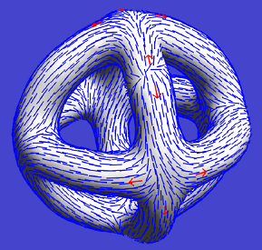
Related work
Vector field design on surfaces
[Praun et al,00]
[Zhang et al,06]
[Turk,01]
[Fisher et al,07]
Notes:
vector field on surfaces is strongly related to texture synthesis on sufaces

Slide 9
Our contribution
Previous work :
Only vector field on surface
Ours :
Design of volumetric vector field

Slide 10
Basic idea
Observation
“Myocardial fibers are parallel to the surface of the heart”
Two-step algorithm
Step 1: Construct tangent vector field
Step 2: Construct volumetric vector field
Notes:
Myocardial fiber orientation is represented by 3D directional unit vector.
Simple sketching on the surface creates volumetric vector fields.

Slide 11
Introduction
User Interface
Stroke on the surface
Stroke crossing the model
Stroke on the cross-section
Algorithm
User Experience
Conclusion

Slide 12
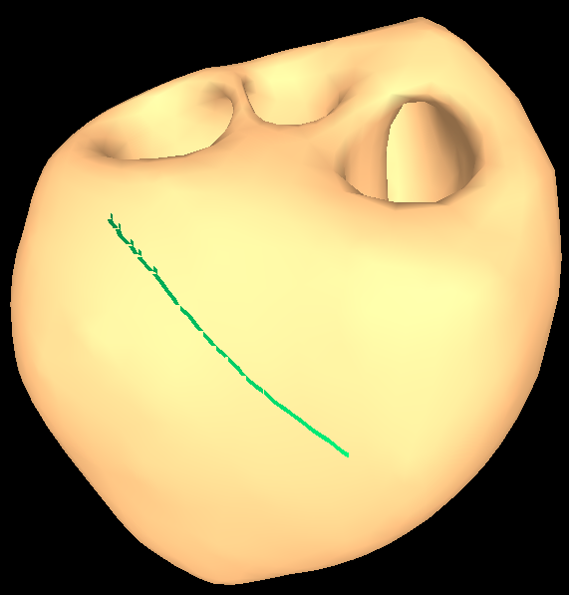
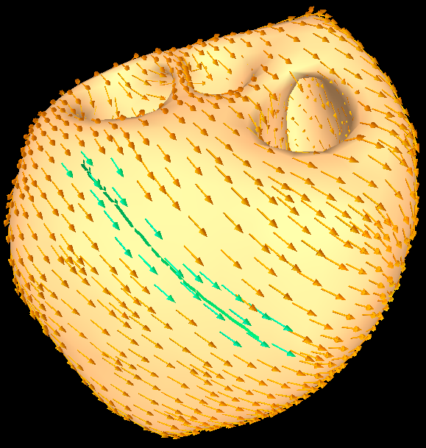
Stroke on the surface
Specify fiber orientations on the surface
Notes:
The user can draw as many strokes as he/she want.

Slide 13
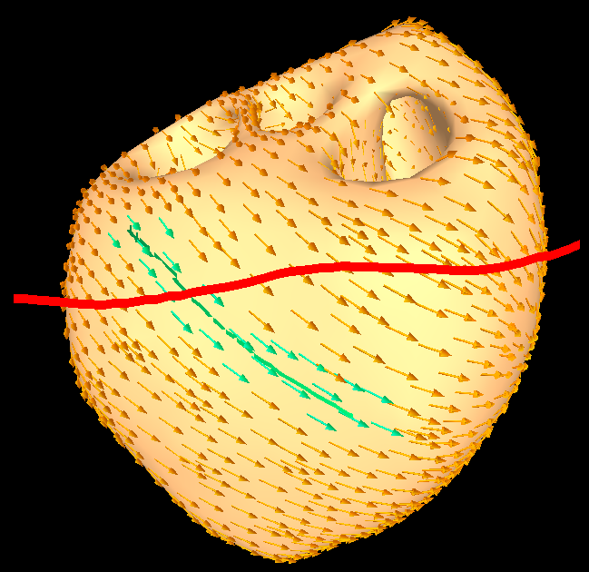
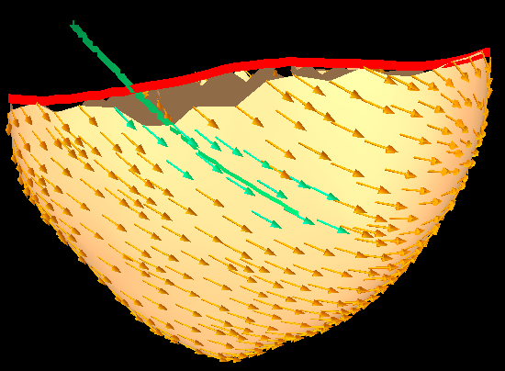
Stroke crossing the model
Cutting
Create cross-sectional surface

Slide 14
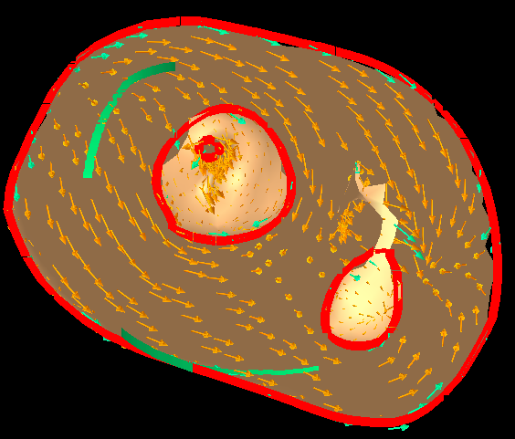
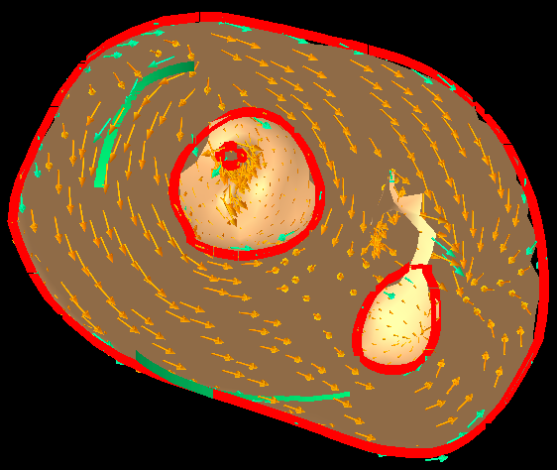
Stroke on the cross-section
Specify fiber orientations inside the model

Slide 15
Demo

Slide 16
Introduction
User Interface
Algorithm
Tangent vector field
Volumetric vector field
Laplacian interpolation
User Experience
Conclusion

Slide 17
Tangent vector field
Sketch
Laplacian interpolation
Tangent vector field
Notes:
On the mesh vertices

Slide 18
Volumetric vector field
Sketch
Tangent vector field
Laplacian interpolation
Volumetric vector field
Notes:
On the voxels

Slide 19
Laplacian interpolation
Minimize Laplacian
Satisfy constraint
neighbor
Laplacian
neighbor
x_{i}

Slide 20
Laplacian interpolation
Matrix form
L
C

Slide 21
Laplacian interpolation
Matrix form
Least-square solution

Slide 22
Laplacian interpolation
Sparse linear system
Precomputable

Slide 23
Introduction
User Interface
Algorithm
User Experience
Preliminary test
Interview
Conclusion

Slide 24
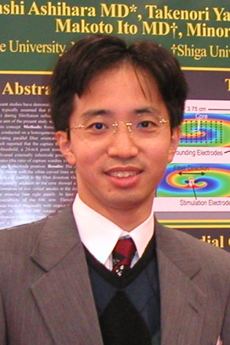
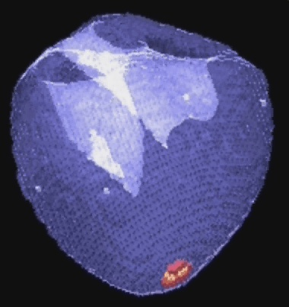
Preliminary test
Asked a physician* to try our system
Sample model by him
In about 8 minutes
Sample simulation result
* T. Ashihara, MD, PhD, Shiga University of Medical Science

Slide 25
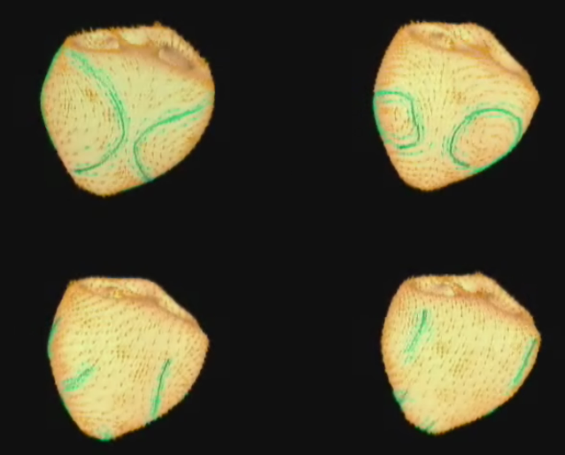
Interview
Positive comments
“We need this tool!”
“Interface is intuitive and quick.”
“This can be a breakthrough.”
Notes:
matches to the images of heart that physicians have
better than working on each 2D slice
direct influence of myocardial fiber orientation
compare
important contribution to medial area

Slide 26
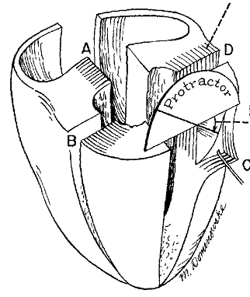
Interview
Points to be improved
“Use of MRI may be needed.”
“Cross-sectioning is not suitable for visualizing fiber orientation.”
Notes:
In real heart, fibers are
Not always continuous
sometimes change suddenly
images of heart are mapped onto the model

Slide 27
Introduction
User Interface
Algorithm
User Experience
Conclusion

Slide 28
Conclusion
Novel method for modeling myocardial fiber orientation
2-step scheme (our contribution)
Surface → Volume
Preliminary user study with a physician
Notes:
Come back to motivation

Slide 29
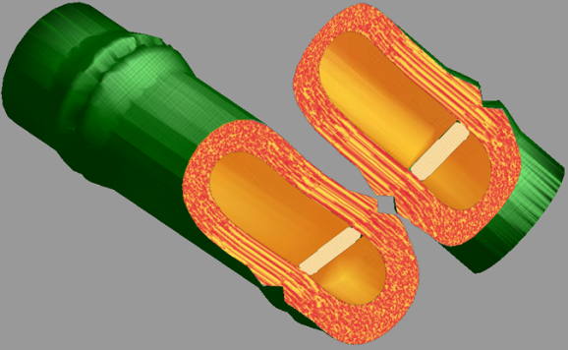
Future work
Test other interpolation algorithms
More formal user test
Use of MRI
Peeling UI
Other applications
Fibers in wood
Particle animation
[Owada et al,04]
Thank you.

